Slide 1
Mechanical Graded Checkpoint

Slide 2
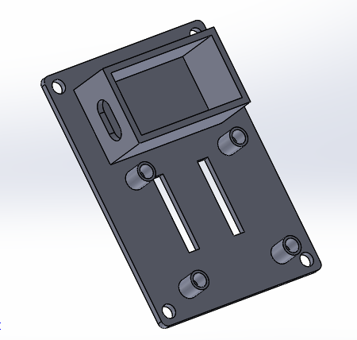
New Bottom Plate Design
9 V battery holder
All connections will be made with 6-32 heat inserts (diameter of holes are 0.220 inches and a draft angle of 2 degrees)
Four elevated spacers 1.74 inches apart from each other.
Velcro holes in order to attach to arm.

Slide 3
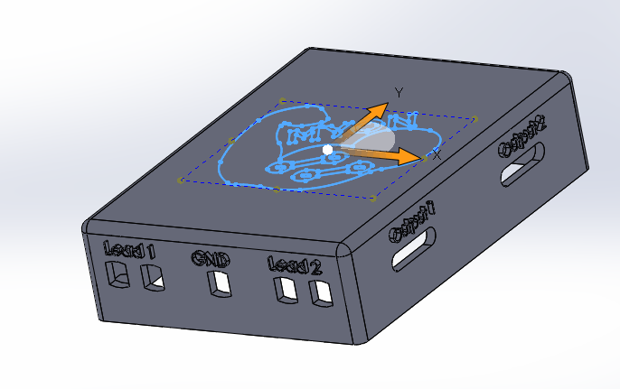
New Cover Design
A total of five female 2mm jack pin connectors (ground and leads)
Two output slots (dimensions aren’t yet set)
Case with logo on top
Fillets with a radius of 0.1 inches for sleekness
3 by 4 by 1

Slide 4
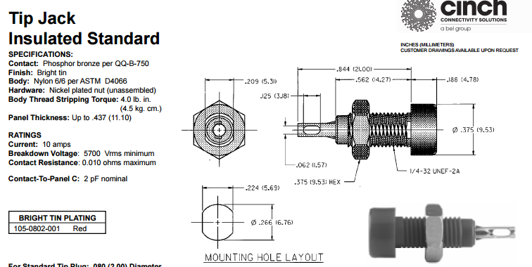
Lead Connections

Slide 5
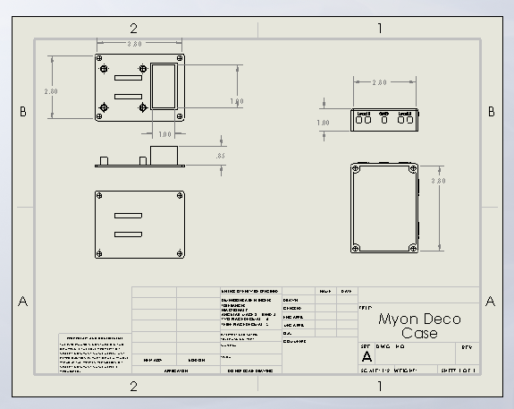
Mechanical Drawings

Slide 6
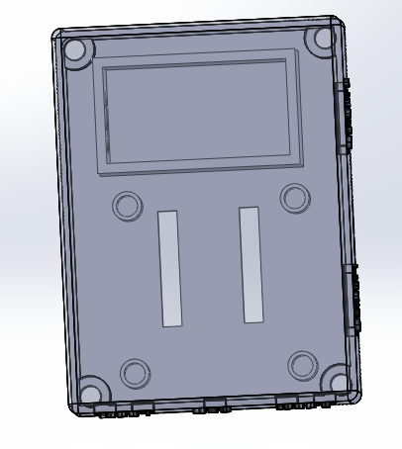
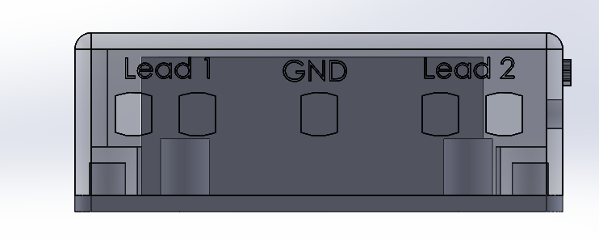
Assembly View

Slide 7
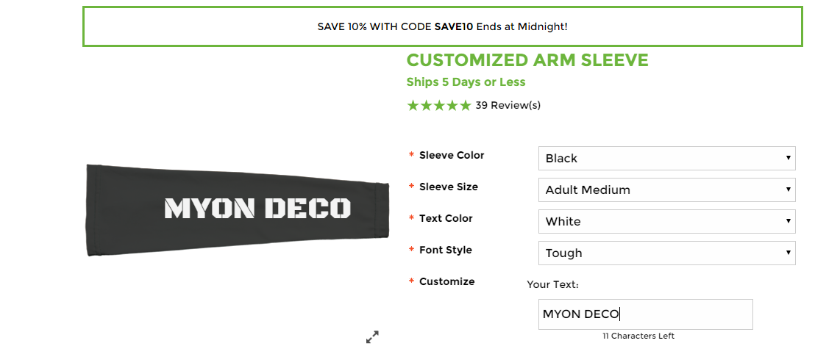
Holding the Electrodes

Slide 8
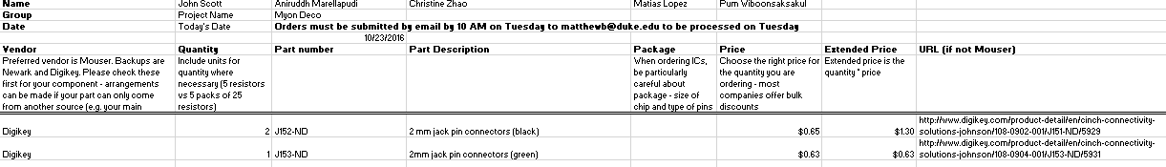
Order Form for This Week

Slide 9
Things still need to be done
Need to determine output connections
Test the heat set screws with new case and bottom plate
Figure out compression sleeve
Optimize location of input and output ports

